Slide 1
Strings

Slide 2
Project Definition
Information on the project organizers
Provide the platform for interactions
Restructure of local sustainability programs
Provide structured information of the projects
Social media connect

Slide 3
Goals
To make eye-catchy website
Increase engagement
Ease of use
Know RCE Saskatchewan better
Think globally act locally

Slide 4
How will we make the website better ?
Responsive website
Suggestion box
Pop up
Map
Opinion poll

Slide 5
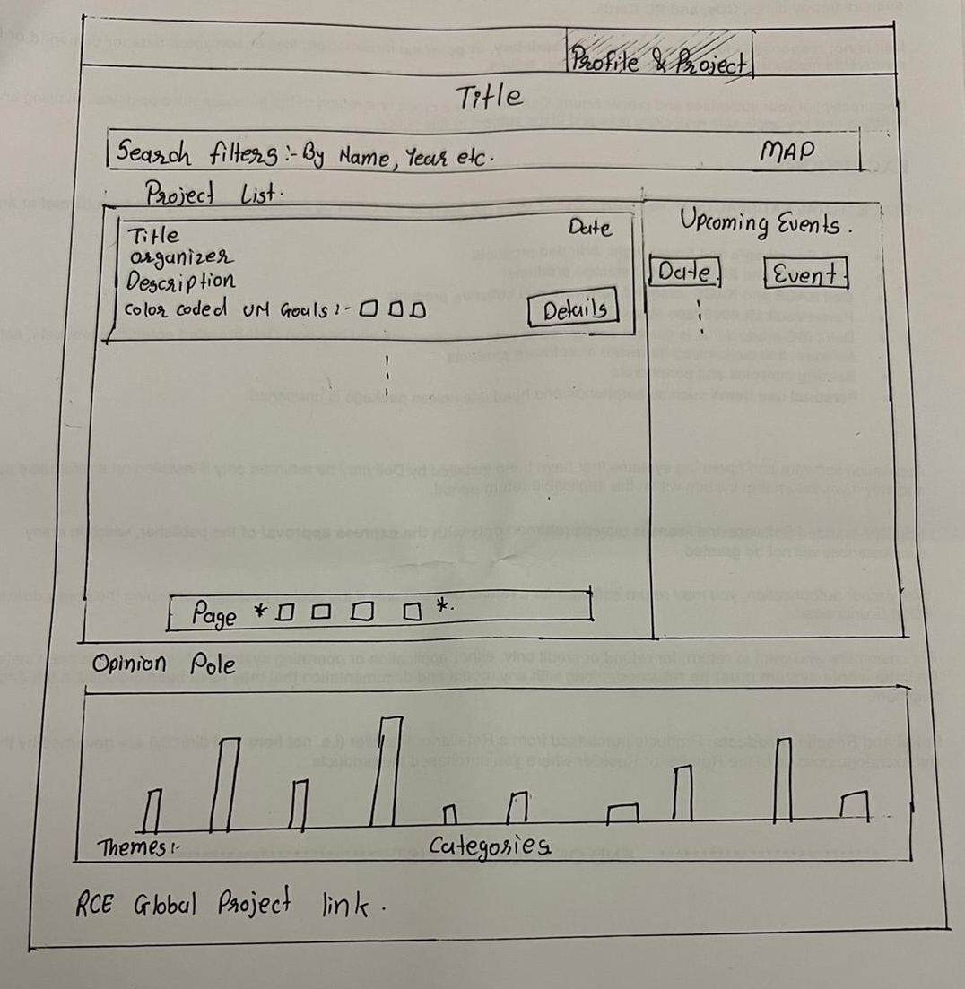
Page design

Slide 6
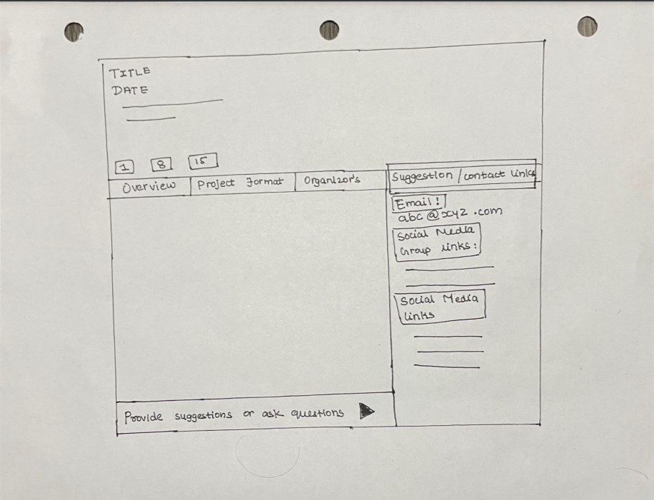
Page design

Slide 7
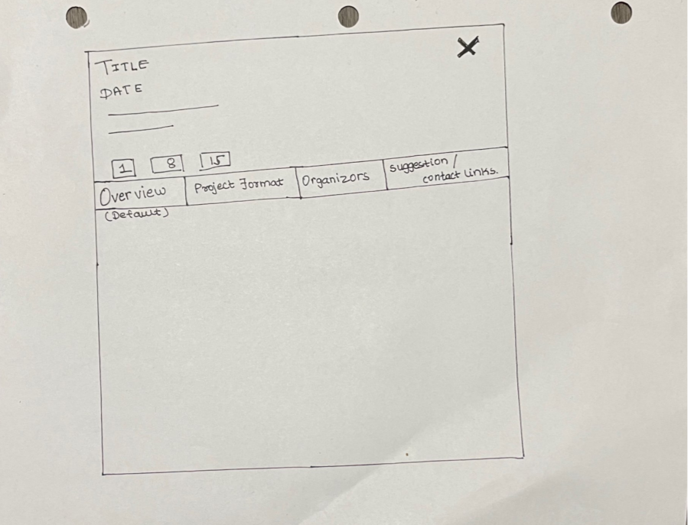
Page design

Slide 8
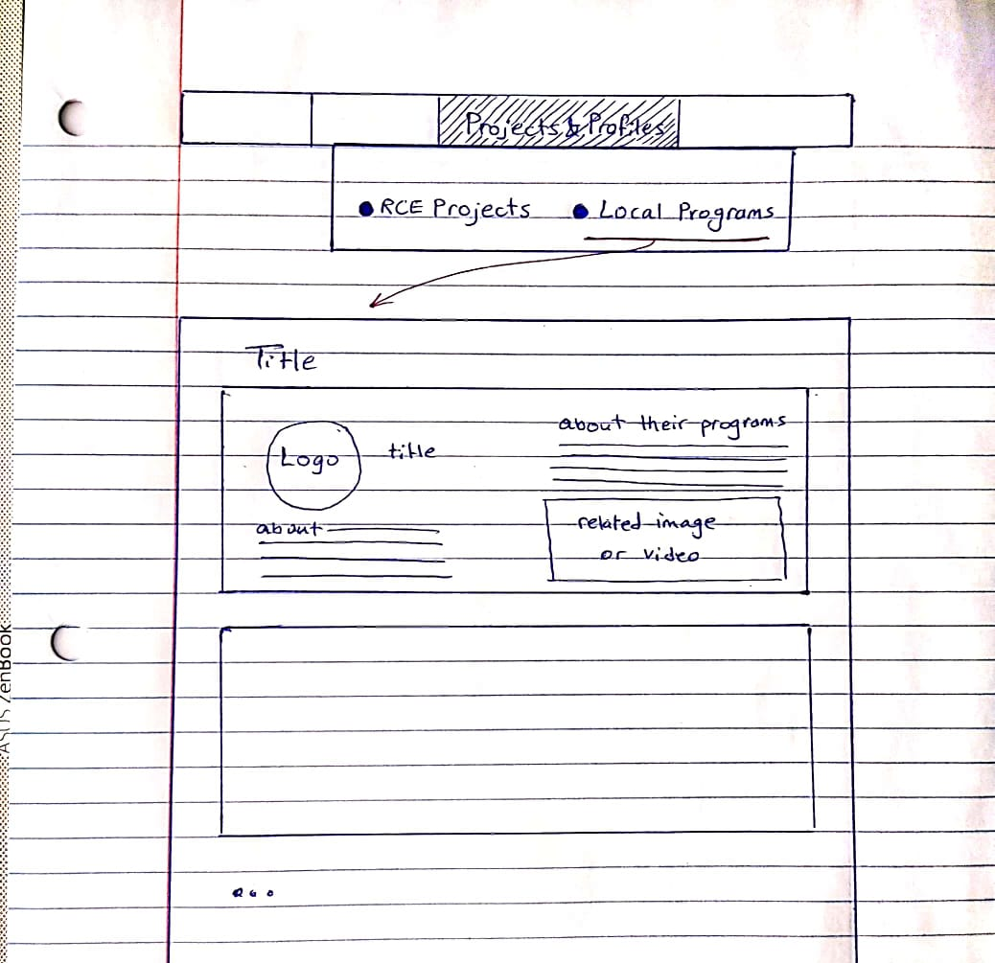
Page design

